Slide 1
2020 – 05 – 28
Library Operating Program
Software engineering
(Team 7)
201636417 심우석
201835461 박한음
2018 전수환

Slide 2

Object
“Library operation program”
A program that systematically manages loans and returns for users and
allows librarians to conveniently manage libraries.
Objects were selected to provide convenience and help users manage books.
Notes:
)

Slide 3





Progress Plan
Search & Check out
Return
User
DB
book management and registration
Librarian
Remove from the book list

Slide 4
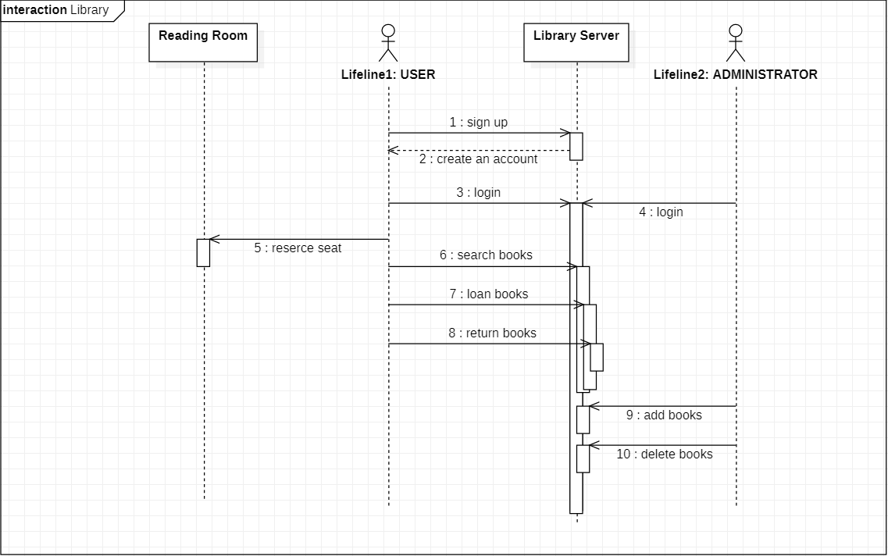
UML

Slide 5
Assignment for Team Members
Park Haneum | Sim Wooseok | Jeon Suhwan
Make proposal PPT | Present proposal | Make proposal PPT
Requirements
System modeling
Architectural design
Implement user function (search, loan, return books) | Implement user function (sign up/ login/ reserve seat) | Implement manager function (login/ add, delete books )
Implement GUI

Slide 6
Schedule
SUN | MON | TUE | WED | THU | FRI | SAT
 |  |  |  | 28 | 29 | 30
31 | 1 | 2 | 3 | 4 | 5 | 6
7 | 8 | 9 | 10 | 11 | 12 | 13
14 | 15 | 16 | 17 | 18 | 19 | 20
21 | 22 | 23 | 24 | 25
Proposal presentation
Requirements
Requirements
System Modeling
Architectural design
Implementation
Implementation
Implementation
Testing
Testing
Preparation for final presentation
Final presentation

Slide 7
THANK YOU

